Slide 1



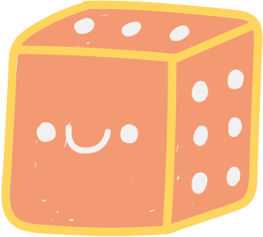



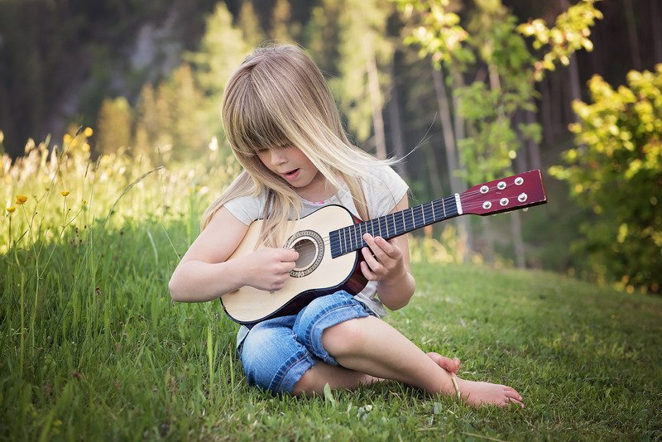




Let's play
The Memory Game

Slide 2









a word for mom:
💥Say each word out loud clearly and loudly when the cards are being presented
💥Encourage your kid to memorize the position of each picture
💥Use English throughout the game and give plenty of positive
encouragement :)

Slide 3








Slide 4


Slide 5


Slide 6


Slide 7


Where is the squirrel?

Slide 8



Slide 9












EXCELLENT!
Good Job!

Slide 10



One more time?
You got this!

Slide 15
Where is the CHESTNUT?

Slide 17


EXCELLENT!
Good Job!

Slide 18


You have found the CHESNUT!

Slide 19
OK, let's TRY A NEW SET OF WOrDS !
Let's Go!

Slide 20


Slide 21


Slide 22


Slide 23


Slide 24
Where is the APPLE?

Slide 26

EXCELLENT!
Good Job!

Slide 27

You have found the apple

Slide 28
One more time?
You got this!

Slide 33
Where is the HEDGEHOG?

Slide 35


EXCELLENT!

Slide 36

You have found the HEDGEHOG

Slide 37






Slide 38



Thanks
for playing
See you next time!

